Slide 1







TASK 2
CORONA VIRUS ANALYSIS WITH SQL
BY: SHIVAM
PROFILE: DATA ANALYST INTERN

Slide 2
CONTENT
1. Introduction
2. Description Of Dataset
3. Question & Answers
4. Valuable Insights

Slide 3
1. Introduction
Project Overview
The CORONA VIRUS pandemic has had a significant impact on public health.
As a data analyst, The tasked is to analyze a CORONA VIRUS dataset to derive meaningful insights by utilizing SQL and Data analysis skills.
This project is a practical assessment of SQL proficiency and data analysis skills in a real-world context.
Through meticulous analysis, the aim is to contribute to understanding the COVID-19 crisis and inform evidence-based public health strategies.

Slide 4
2. Description of Dataset
Description of each column in dataset
Province: Geographic subdivision within a country/region.
Country/Region: Geographic entity where data is recorded.
Latitude: North-south position on Earth's surface.
Longitude: East-west position on Earth's surface.
Date: Recorded date of CORONA VIRUS data.
Confirmed: Number of diagnosed CORONA VIRUS cases.
Deaths: Number of CORONA VIRUS-related deaths.
Recovered: Number of recovered CORONA VIRUS cases.

Slide 5
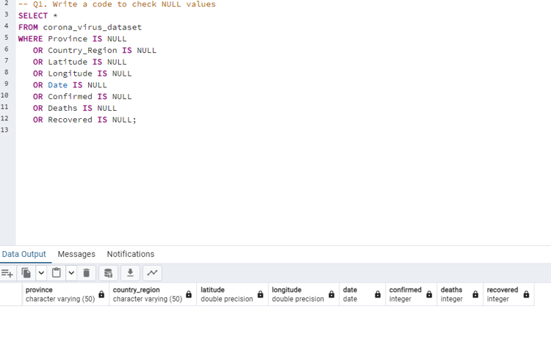
3. Question & Answers
Q1. Write a code to check NULL values

Slide 6
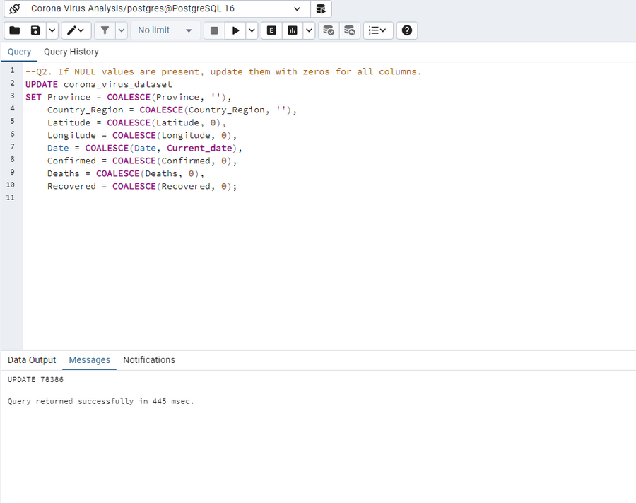
Q2. If NULL values are present, update them with zeros for all columns.
As we have already checked in the first query there are no null values but still, If the values were null from any column we can address them using this query.

Slide 7
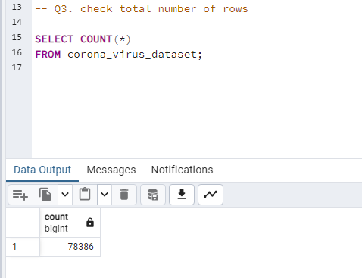
Q3. Check total number of rows

Slide 8
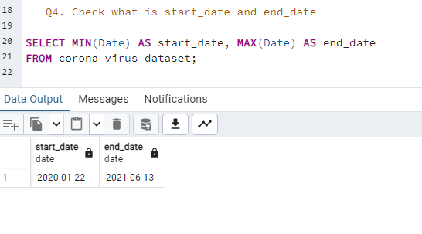
Q4. Check what is start_date and end_date.

Slide 9
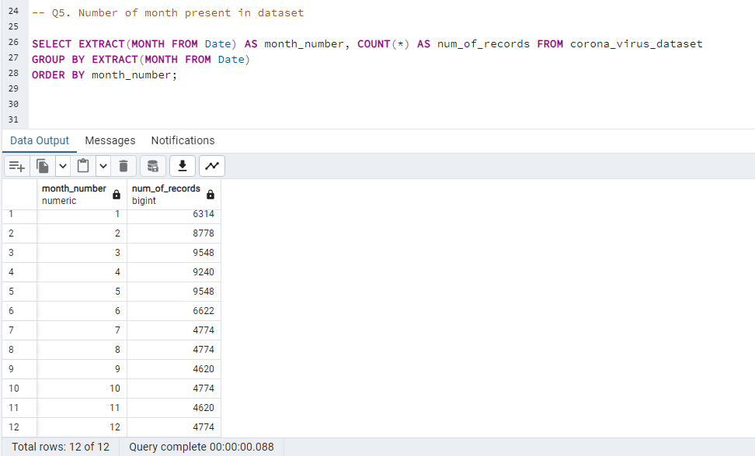
Q5. Number of month present in dataset

Slide 10
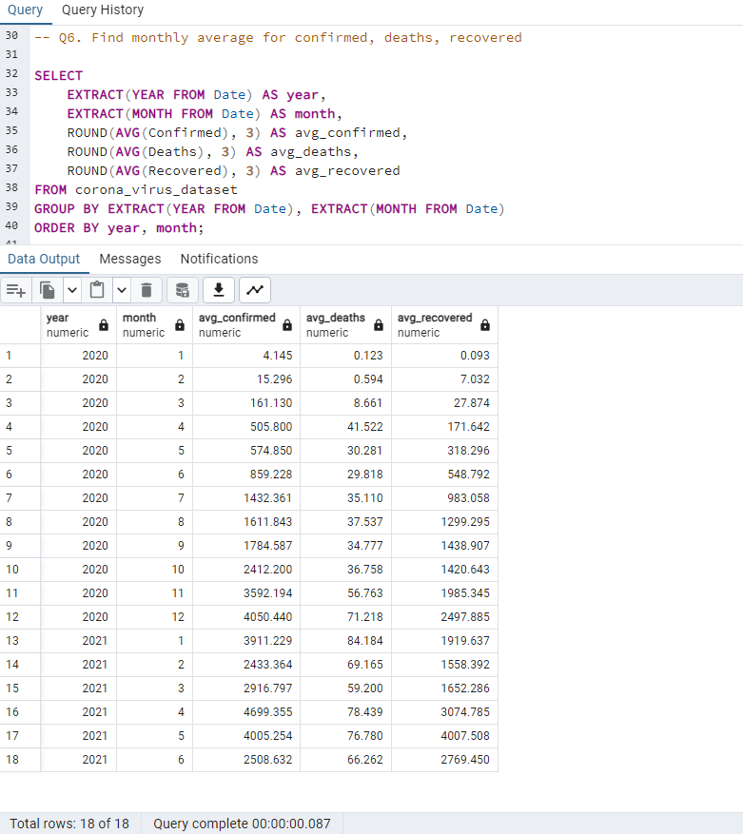
Q6. Find monthly average for confirmed, deaths, recovered.

Slide 11
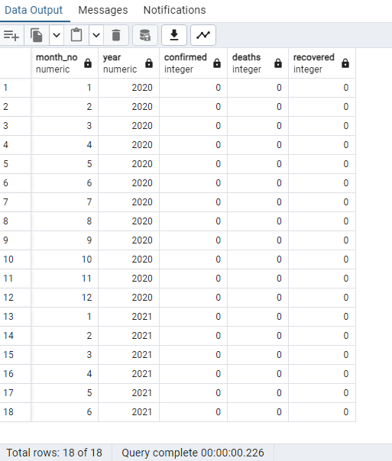
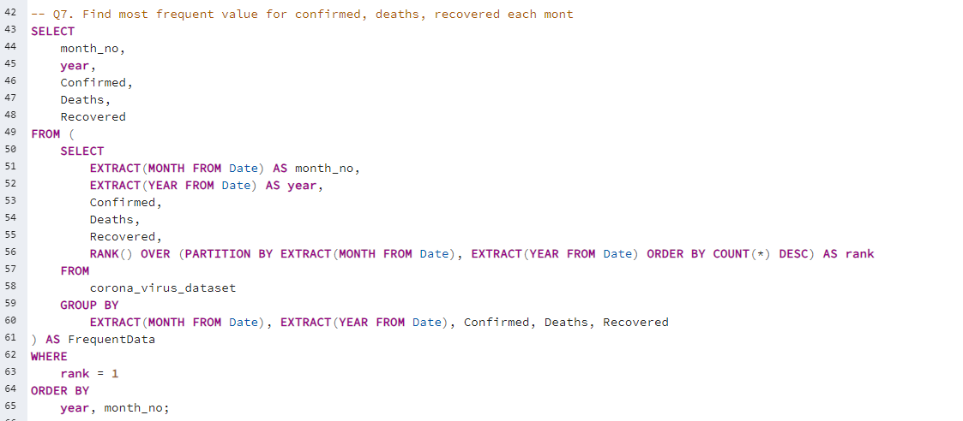
Q7. Find most frequent value for confirmed, deaths, recovered each month

Slide 12
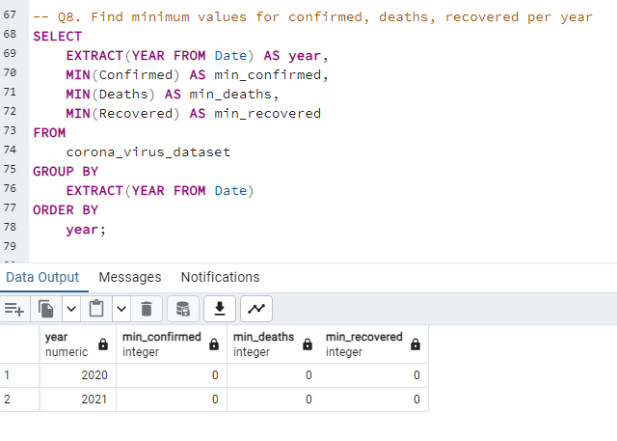
Q8. Find minimum values for confirmed, deaths, recovered per year.

Slide 13
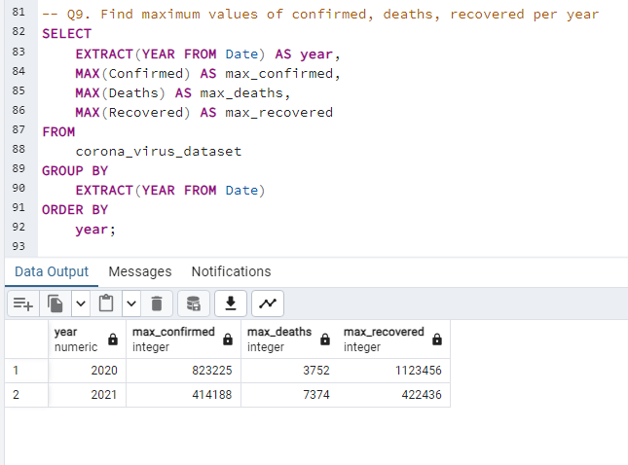
Q9. Find maximum values of confirmed, deaths, recovered per year.

Slide 14
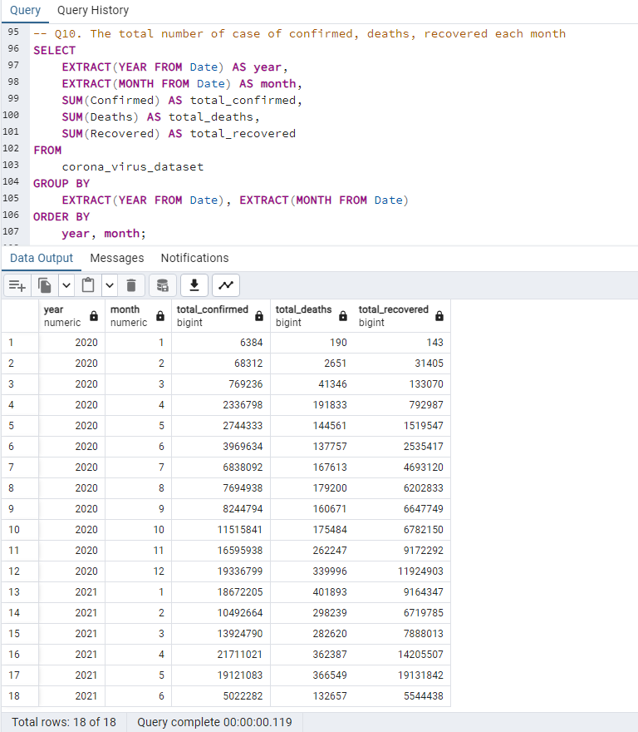
Q10. The total number of case of confirmed, deaths, recovered each month.

Slide 15
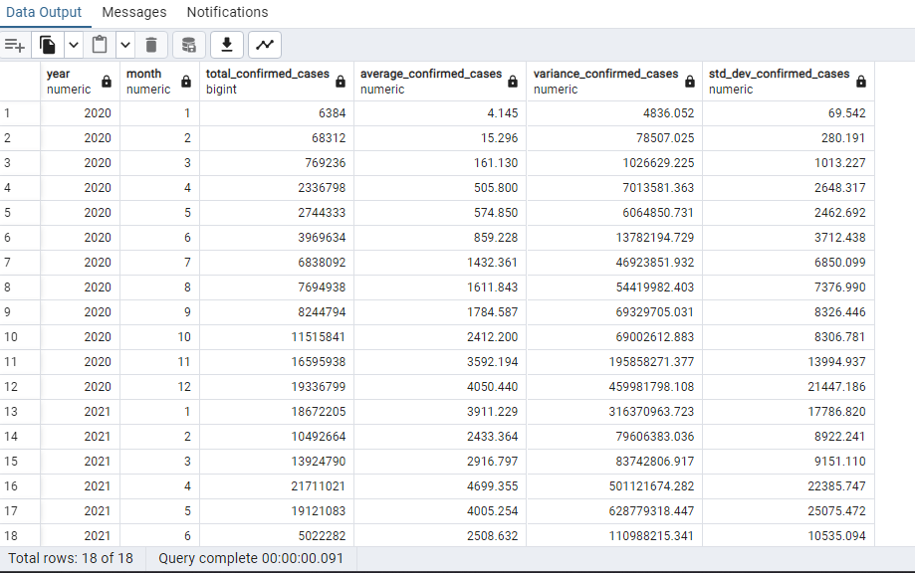
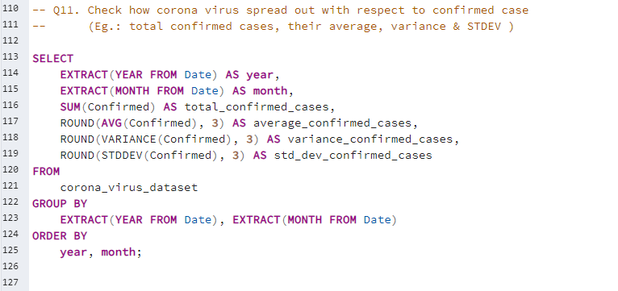
Q11. Check how corona virus spread out with respect to confirmed case
(Eg.: total confirmed cases, their average, variance & STDEV)

Slide 16
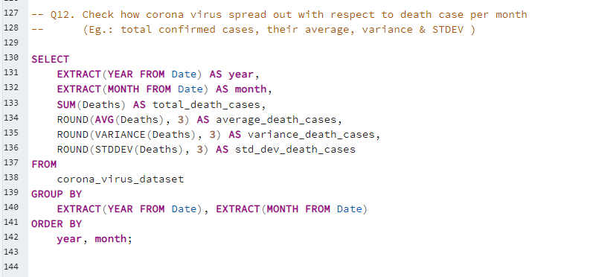
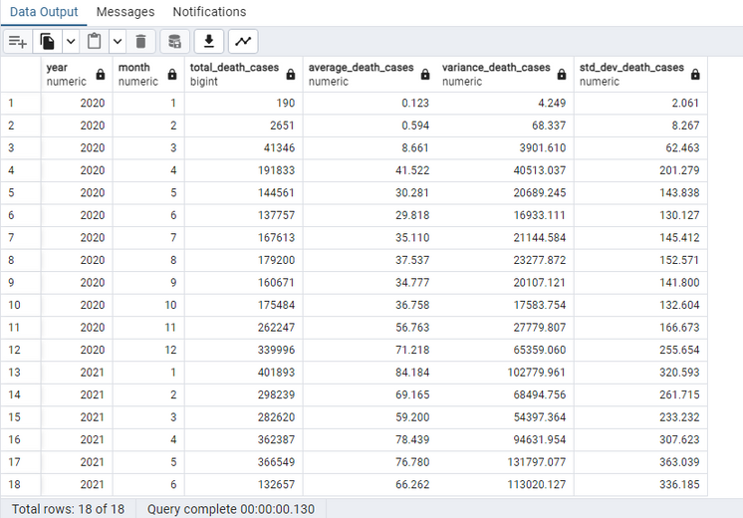
Q12. Check how corona virus spread out with respect to death case per month
(Eg.: total confirmed cases, their average, variance & STDEV )

Slide 17
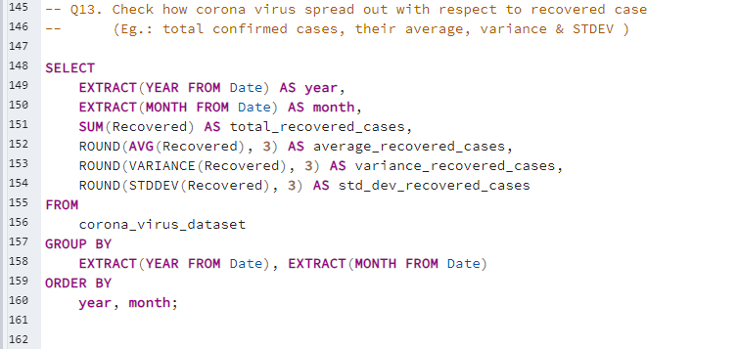
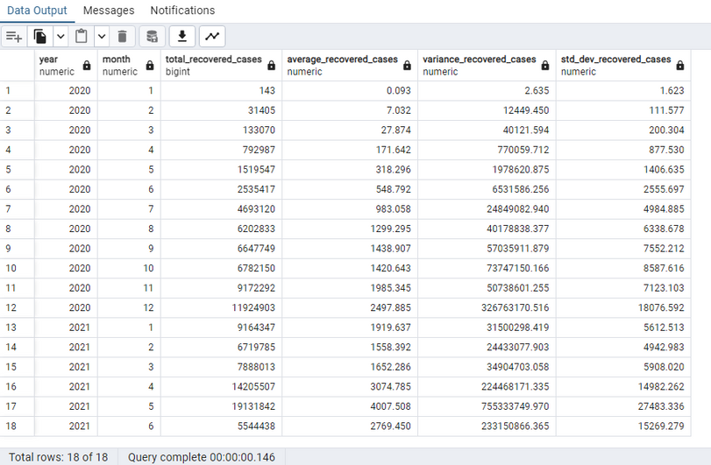
Q13. Check how corona virus spread out with respect to recovered case
(Eg.: total confirmed cases, their average, variance & STDEV)

Slide 18
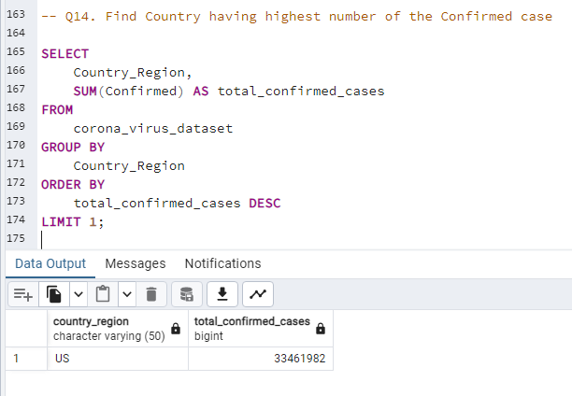
Q14. Find Country having highest number of the confirmed case

Slide 19
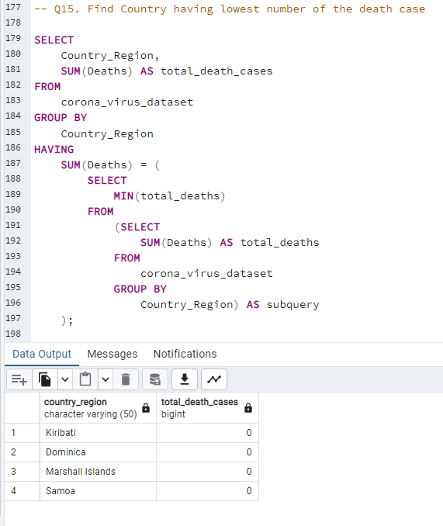
Q15. Find Country having lowest number of the death case

Slide 20
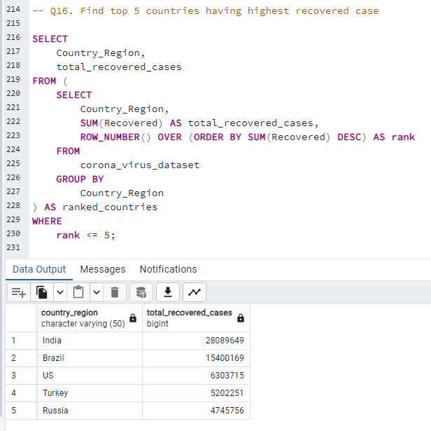
Q16. Find top 5 countries having highest recovered case.

Slide 21
4. Insights
Here are the main findings from analyzing the Coronavirus data:
The dataset looked at COVID-19 from 22 January, 2020, to 13 June, 2021.
Despite fewer cases, more people died from COVID-19 in 2021 compared to 2020.
India had the most people recover from COVID-19 worldwide.
April 2021 had a big jump in confirmed COVID-19 cases worldwide.
Countries like Samoa, Kiribati, Dominica, and Marshall Islands had the fewest reported deaths from COVID-19.
The US had the highest number of confirmed cases, but India had more recoveries in the dataset.
These findings show how the pandemic progressed over time, where cases were concentrated, when cases spiked, and which countries were most and least affected by COVID-19.

Slide 22
THANK YOU

